Slide 1
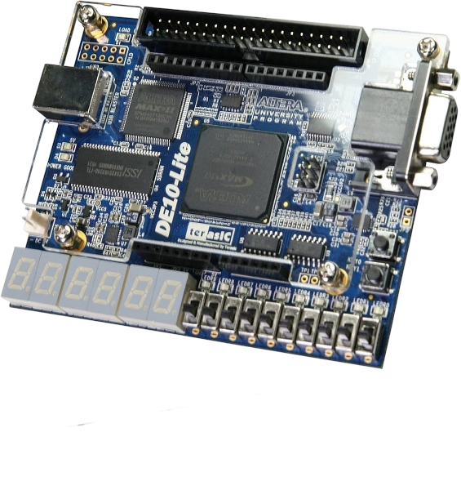
FPGA design #1 Basic logic design
On DE10-lite platform
Avi Salmon.

Slide 2
https://www.youtube.com/watch?v=G8-lkebvnhE
https://www.youtube.com/watch?v=2iRPEooKhQ4

Slide 3
What will you learn
Course #1 – Basic Logic design on FPGA
Course #2 – implementing Retro games on FPGA
Course #3 – Building a working computers on FPGA

Slide 4
Why should I learn to program an FPGA?
Become a logic design Hardware engineer.
Stand out in a talent-short market: companies can’t hire enough FPGA-savvy engineers—your skills become instantly valuable.
Prototype at warp speed: edit-compile-flash cycles take minutes, turning ideas into Hardware in the same day.
Design literally anything in silicon: from custom CPUs to retro game consoles—FPGAs make your imagination the only limit.
Have fun!

Slide 5
What will the course cover
Basic logic design on FPGA
Advanced IP modules (Memory, PLL)
Connecting to I/O, LEDs, switches
Connecting to a VGA screen
Validating with simulation
Debug on the HardWare

Slide 6
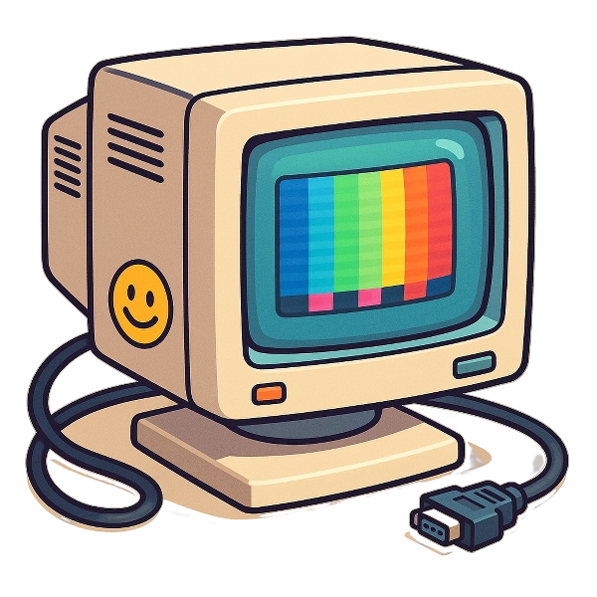
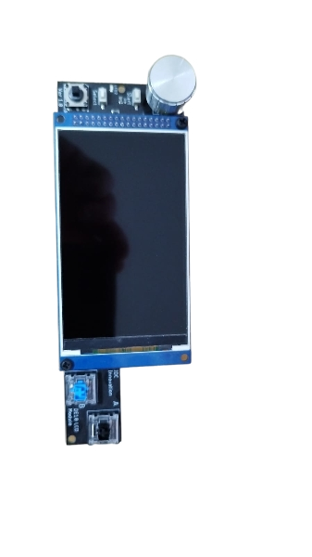
What do you need to have?
An Altera DE10-lite platform.
Relatively not expensive and available.
A VGA screen.
Optional: Property additional add-on board

